Slide 1
AIML Part A Time Series: Air Pollution Data
Jayden Yap Jean Hng p2112790

Slide 2
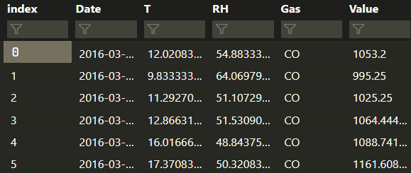
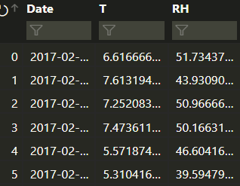
Dataset
Training set:
328 days of data for 4 gases, CO, HC, NO2 and O3
1312 total rows
Columns:
Date
Gas name
Gas pollutant value
Temperature (in C) of day -> Exogenous variable
Relative Humidity of day -> Exogenous variable
Test set:
63 days of data
Temperature and Relative Humidity
Gas name and gas value to be predicted by us
252 total predictions

Slide 3
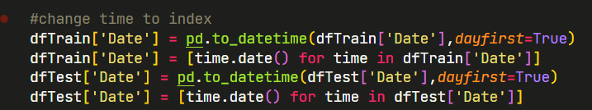
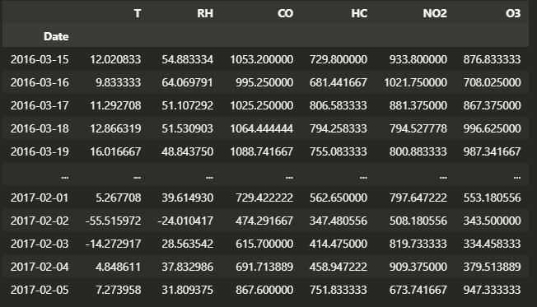
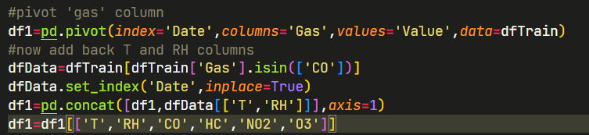
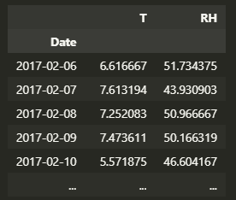
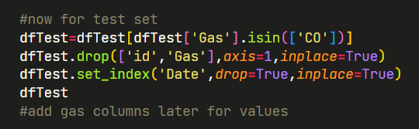
Data Cleaning
Change Date column into the index , as well as converting to Datetime Datatype
Pivot training set so one row for each day (instead of 4) ---->
Same for test set, we will add the gas columns with their values later after predictions ------------------->

Slide 4
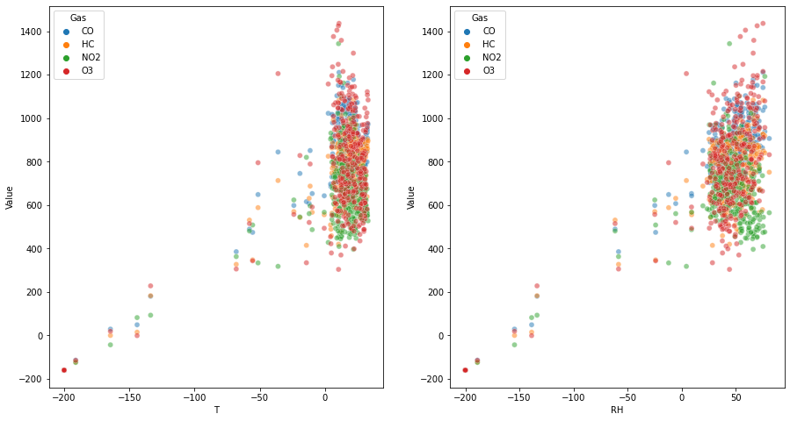
Data Visualisation
Visualise relationships between:
Pollutant Value and Temperature
Pollutant Value and Relative Humidity
Overall, we can see that there is a linear positive relationship for both variables. I.e more humidity = more pollutants, higher temperature = more pollutants
It is important for algorithms to take into account these variables when predicting, so likely that algorithms that take into account Exogenous variables are needed

Slide 5
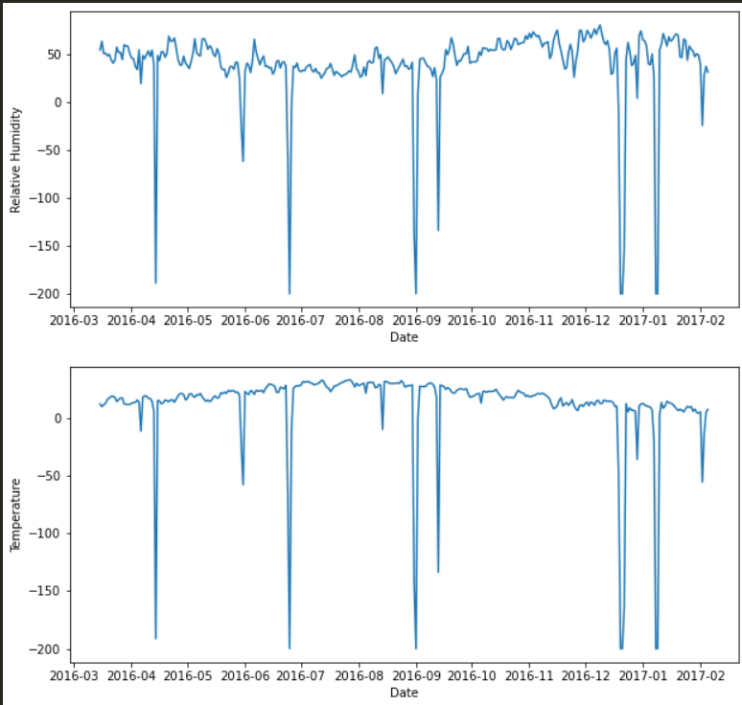
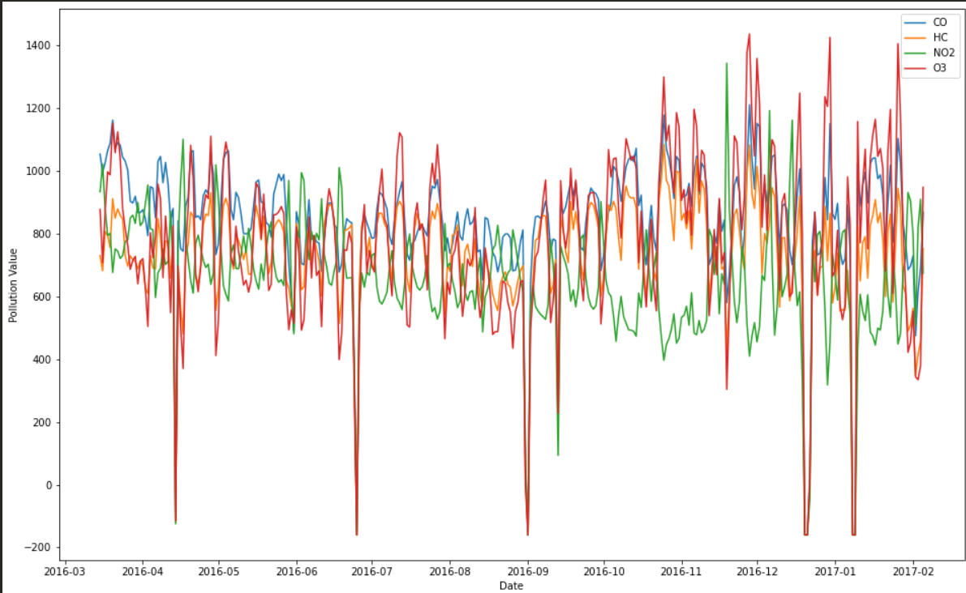
Data Visualisation
Plot the temperature and humidity over time
Plot the pollution value over time
(colour indicates gas name)
Overall, there is a lot of noise and there are not many patterns easy to notice by eye
There are a few days where temperature and humidity drops to extremely low levels (negative values)
These are outliers that we need our algorithms to be able to capture, especially because test set also contains days with negative values like this.

Slide 6
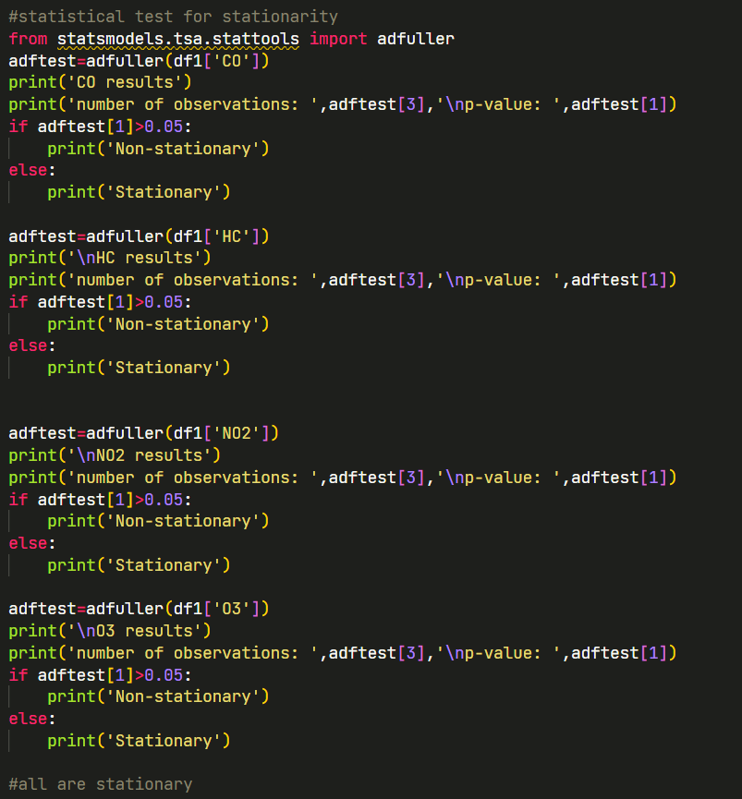
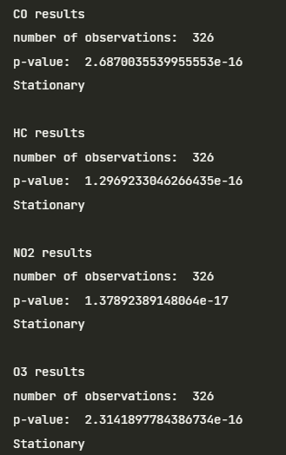
Stationarity Test
Stationary data: Properties do not depend on the time at which the series is observed
Use Adfuller test
NOTE: There could still be trends or seasonal components but it is likely that they are not strong
Results show that all results were stationary

Slide 7
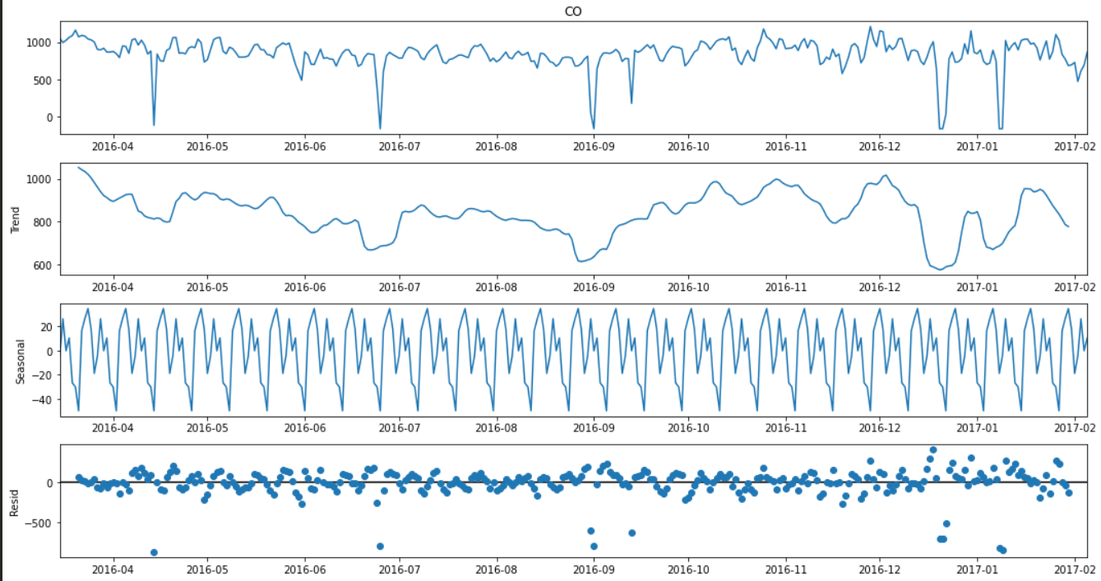
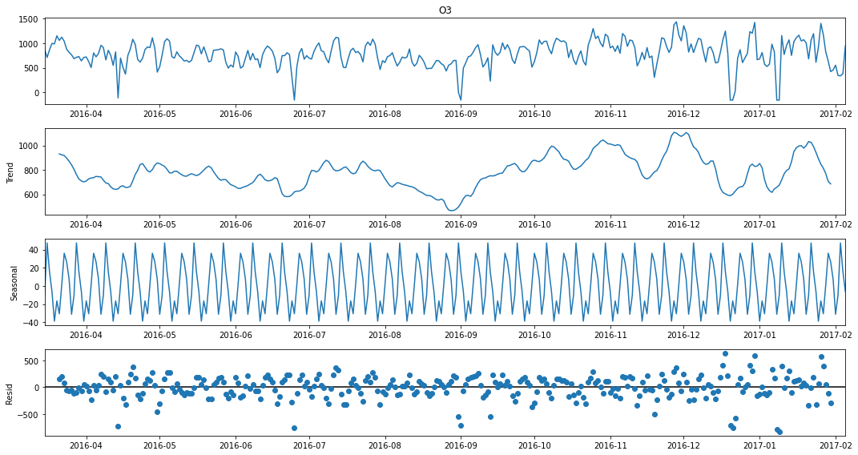
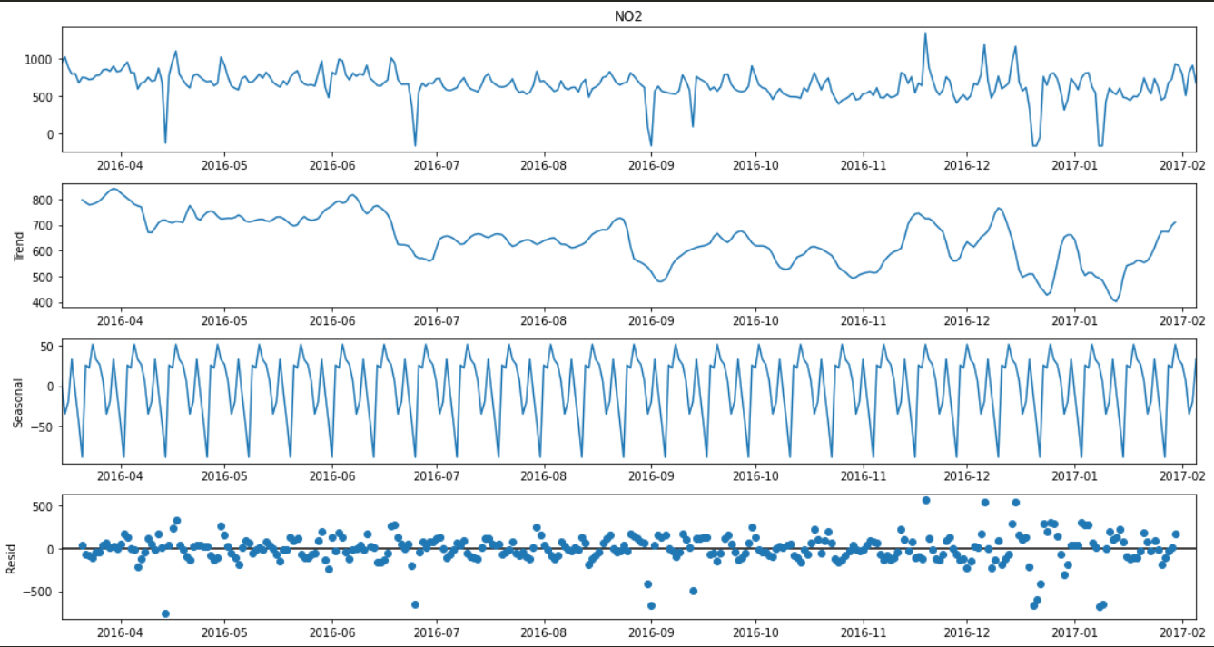
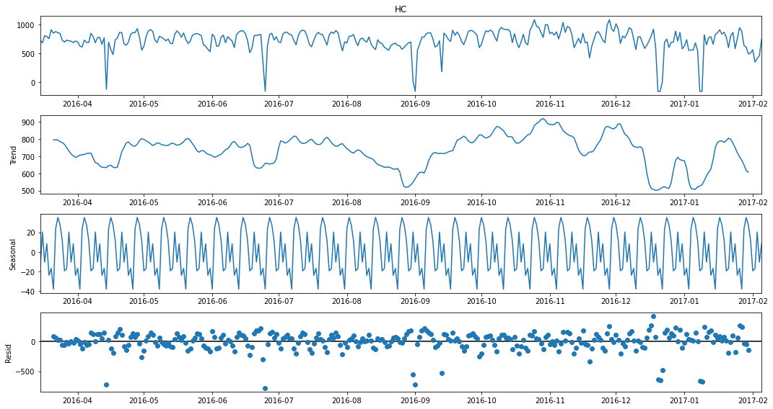
Seasonal Decomposition
Other gases results were similar
Trend shows non-linearity , hence no strong trend
However, there is some seasonality that is 6-7 days long cycles (1 week)
This goes for all 4 of the gases

Slide 8
Seasonal Decomposition
Other gases results were similar
Trend shows non-linearity , hence no strong trend
However, there is some seasonality that is 6-7 days long cycles (1 week)
This goes for all 4 of the gases

Slide 9
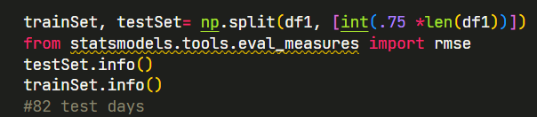
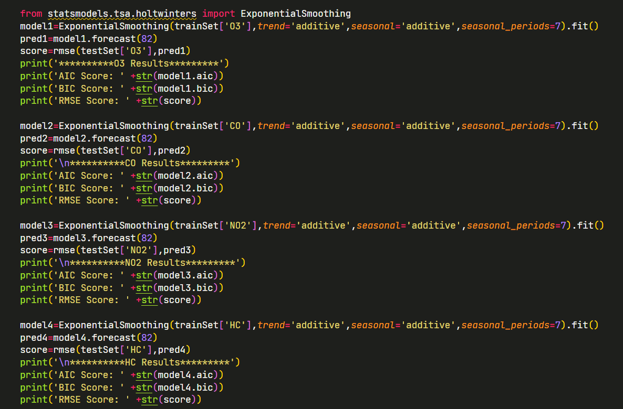
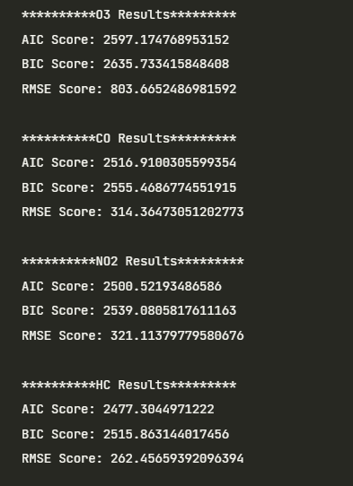
Testing Models
First split the TRAIN data further into train and test sets
We will have 82 test days
For each model:
Fit training set, test on test set for all 4 gases' values
Measure AIC and BIC scores which measure model complexity, generally lower will be better
Measure RMSE against true value, lower is better
Models tested:
Exponentional Smoothing
ARIMA
SARIMAX
VARMAX

Slide 10
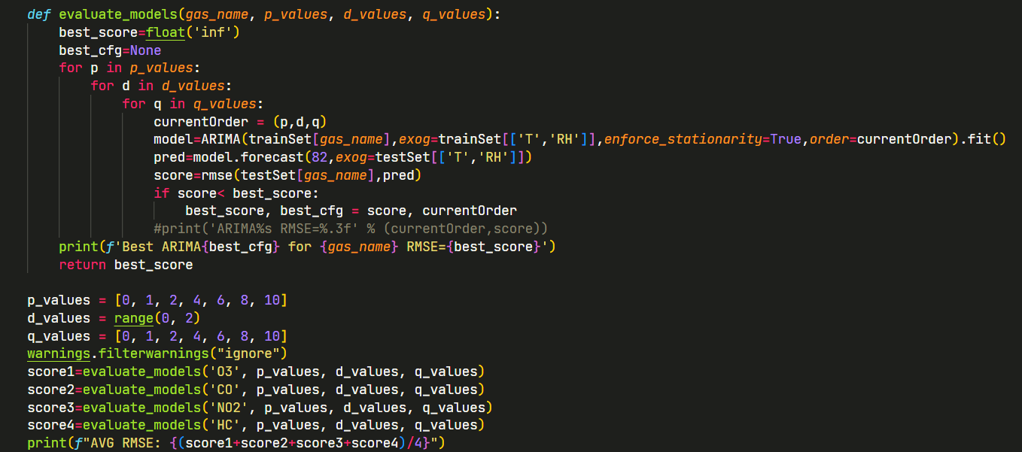
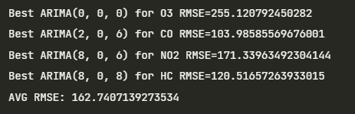
Hyperparameter tuning
ARIMA, SARIMAX and VARMAX can use Exogenous variables and produced best results so we will tune these 3 models
Tune twice , once without seasonality component and one with it
Tune the 'order' and 'seasonal_order' parameters respectively with range of (p,d,q) values
Then display best RMSE score for each gas with best configuration orders

Slide 11
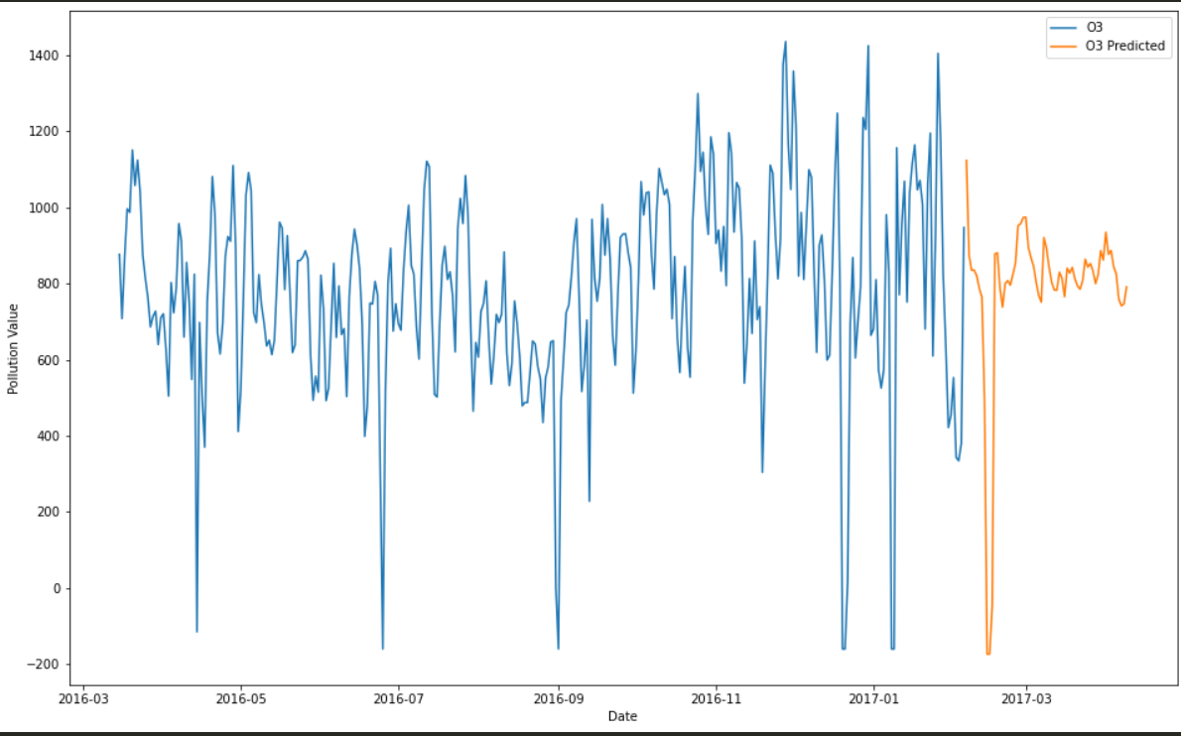
Final results
For final testing we have to train with ALL training data on the actual test set to submit
Since we have 4 gases to predict, we will take the best model for each gas, these 4 models will form 1 set of results
I try 3 different sets of results to produce 3 sets of results
Set 1:
O3: SARIMAX seasonal_order=(8, 0, 2, 7)
CO: SARIMAX seasonal_order=(4, 1, 1, 7)
NO2: SARIMAX seasonal_order=(4, 0, 1, 7)
HC: SARIMAX seasonal_order=(8, 1, 2, 7)
Set 2:
O3: SARIMAX seasonal_order=(8, 0, 2, 7)
CO: SARIMAX seasonal_order=(4, 1, 1, 7)
NO2: ARIMA seasonal_order=(1, 0, 0, 7)
HC: ARIMA seasonal_order=(10, 0, 8, 7)
Set 3:
VARIMAX with order: (0, 3), c trend for ALL gases

Slide 12
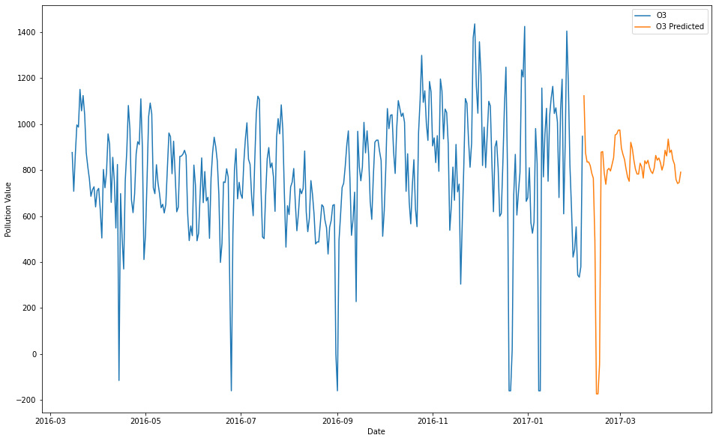
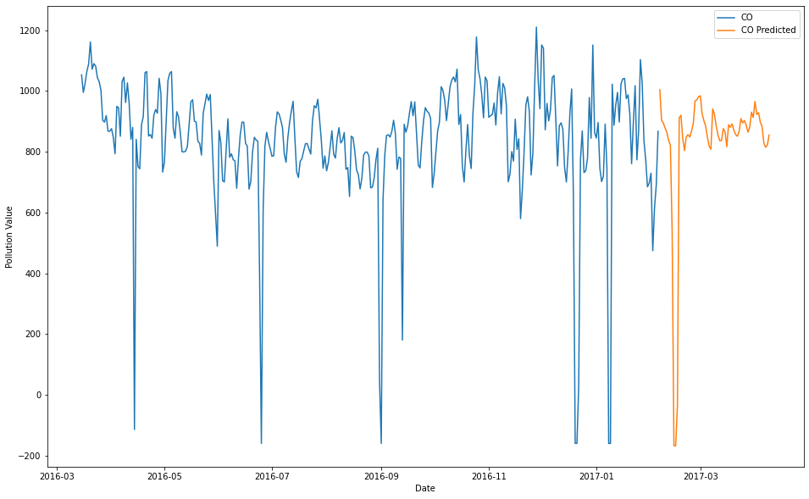
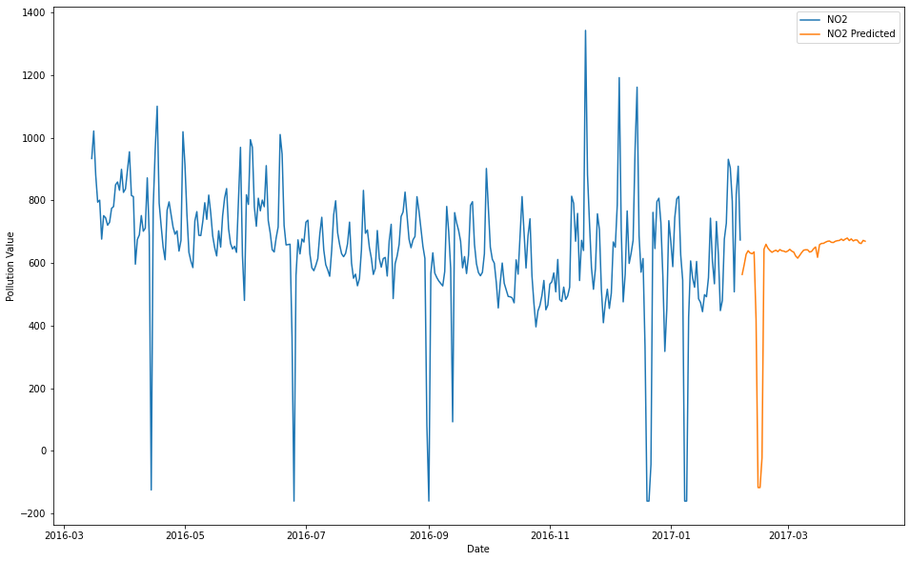
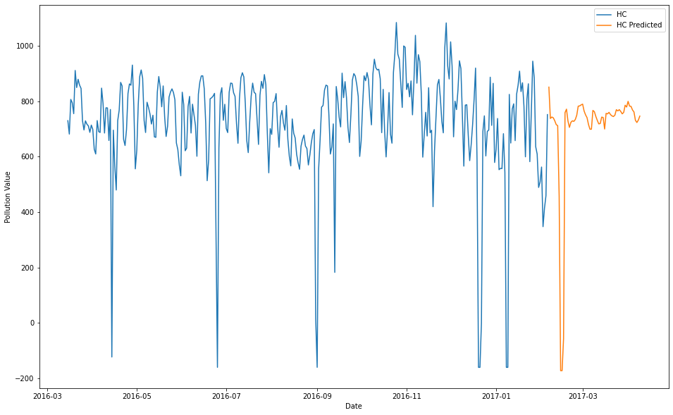
Best set
Best performing dataset on Kaggle was Set 3 VARIMAX
Produce 4 graphs for each gas with new predicted values
Was able to account for anomaly data in test set (very low temperature and humidity)

Slide 13
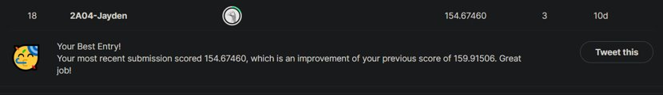
Thank You !
Got a good result on Kaggle!

